Slide 1
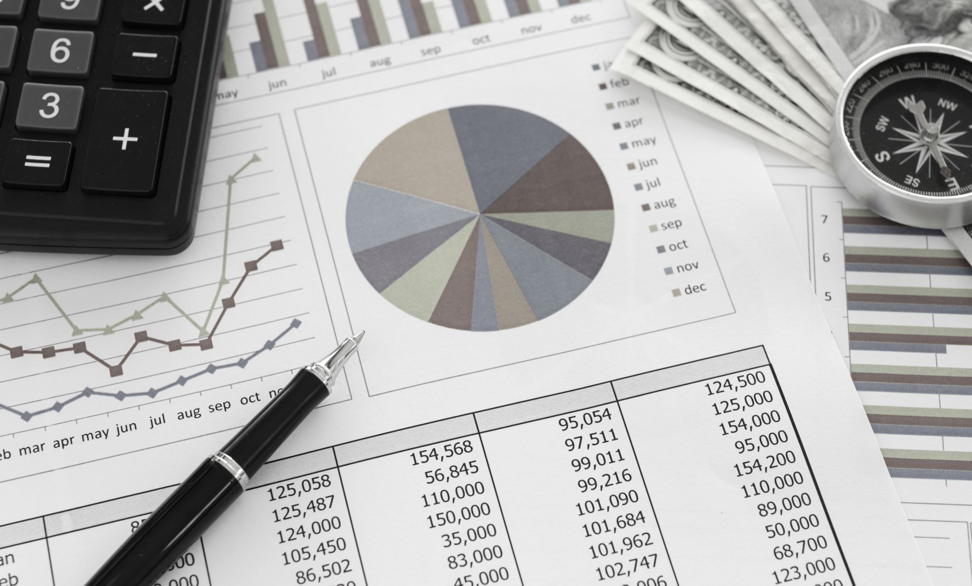
Managing Sales Promotions
L03

Slide 2

Today’s Consumer
Has lot of expectations
Is Unpredictable
Has a large range of promotions to choose from in almost all the product categories

Slide 3
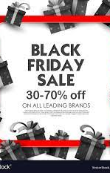
Why Analyze Promotions?
Which promotional offers are creating an impact
Understand success and failure of promotions

Slide 4
What is Promotions Analysis?
Technique of evaluating success or failure of a promotion using past time series data.
It can be understood as discovering a correlation between sales patterns and marketing efforts which includes promotions offered and advertising.
The objective of promotional analysis is to help a retailer understand the impact of past promotions and hence formulate future strategies which could be applied and adapted to produce profitable results.

Slide 5
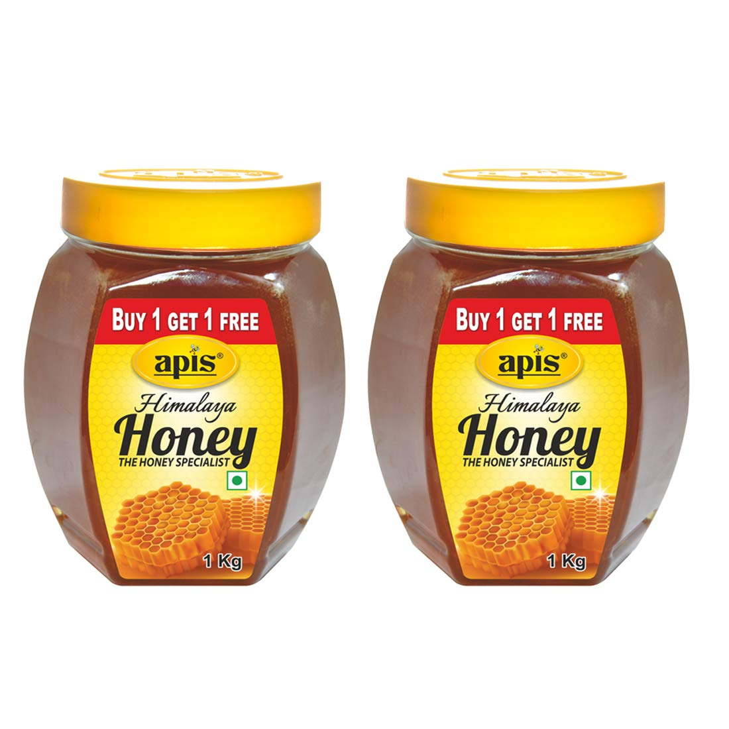
Types of Promotions
1. Quantity/Product concession
1) Buy one get one free
2) Innovative cross-sell and up-sell strategies
3) Free samples to test new product
4) Offering promotions on particular day of a week to drive sales
5) Pseudo personalized promotions targeting particular customer segment (students/promotions linked to age, height, gender, profession)

Slide 6
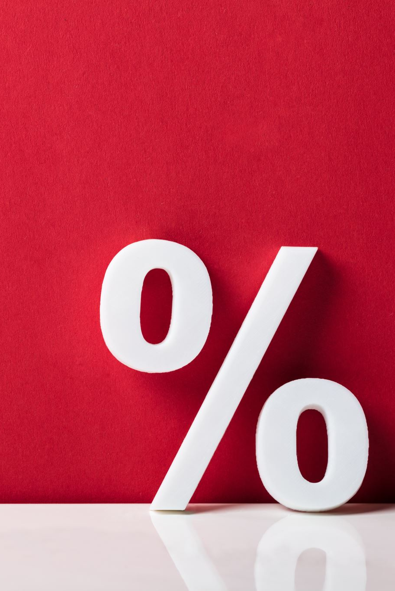
Types of Promotions
2. Price discount
1) Some per cent off per item
2) Fixed amount off per item
3) Discount vouchers
3. Coupons
1) On-line/e-mail coupon
2) Mobile coupon
4. Shipping promotions
1) Free delivery of product
2) Money off on delivery item by means of a selected ship mode

Slide 7
The ORACLE
Mere sales is not enough
Promotions must draw profits
Customer behavior must be analyzed
Customers have their own parameters to evaluate a promotion:
Age
Gender
Requirement
Income

Slide 8
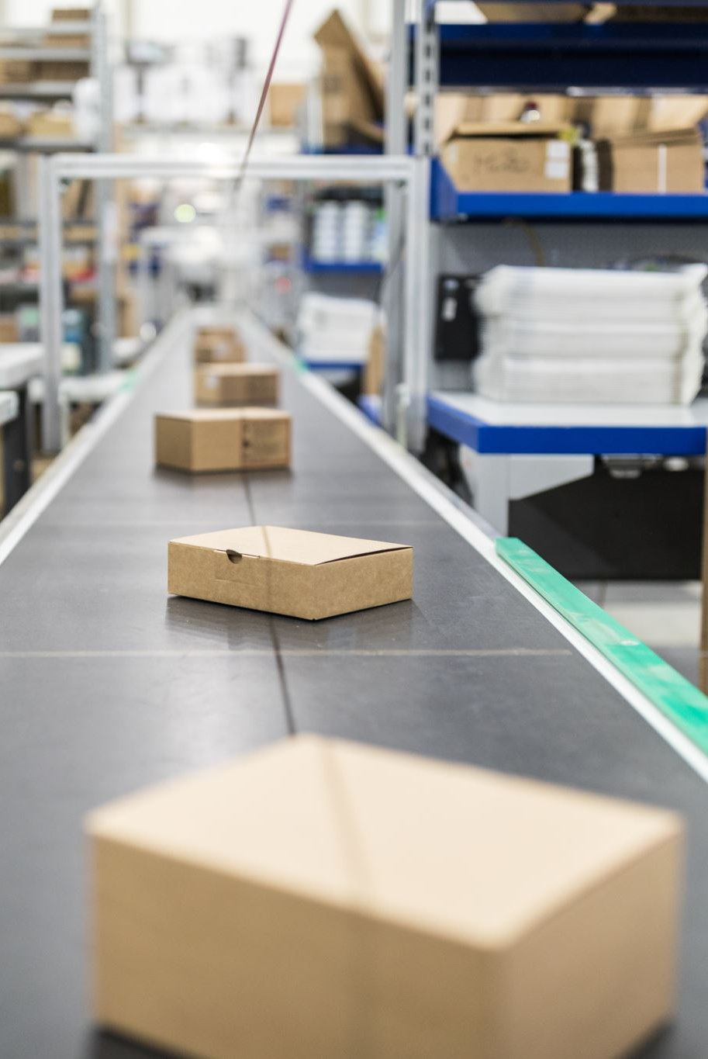
Knowledge Prerequisites
1. How frequently should a promotion be launched? 2. Which categories respond the most to which promotions? 3. What product combinations can be promoted together? 4. To promote the entire category or to concentrate on only key products? 5. What sales rise can be estimated at each concession level? 6. How does a retail price change in product affect traffic and overall revenue? 7. What promotional plan to be designed to meet definite sales and volume targets? 8. Do price increase/decrease on some items negatively impact sales of other items? 9. How to drive new traffic to stores? 10. Based on demographics, how to vary promotional strategies across various stores? 11. What are the most effective promotions to reach target customers?

Slide 9

Direct – Indirect Impact of Promotions
Increased Profits
Increased Revenue
Increased Brand Awareness
Clear Stocks
Build Strong Relationships with Loyal Customers

Slide 10
Data Points to Watchout for
Customer behavior
Sales pattern
Seasonality
Impact of location
Special events
Product performance
Repeat purchases
New customers

Slide 11
Some Popular Analysis Techniques
Regression
Time Series Analysis
Intervention Analysis
Predictive Analysis
What-if Scenarios
Marketing Mix Models

Slide 12
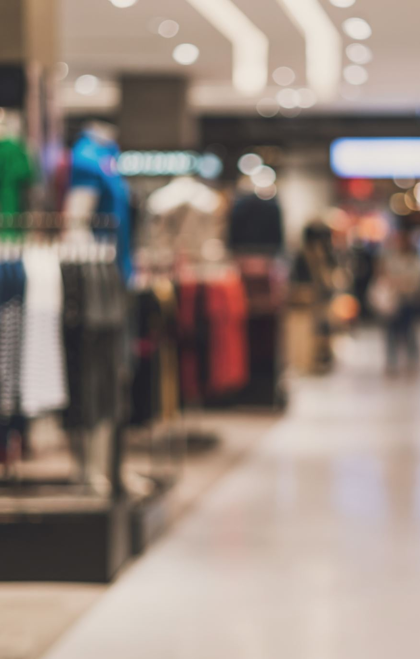
Promotional Analysis
Retailers capture detailed data customer-wise which helps in giving insight not only about a product and their brands purchased but also the socio-demographic nature and buying pattern of a customer. Various parameters can be judged using such approach.
1) Whether the promotion targets new customers
2) Repurchase history
3) Cannibalization
4) Shift from competitor brand/product
5) A loyal customer who would have purchased the product even without the promotion.

Slide 13

Promotion is not just Offering Anything
Shampoo cannot be promoted with biscuits. Customers who tend to buy biscuits lean to buy other snacks like cake, cookies etc. To promote slow moving shampoos, a best promotion plan would be to offer them with conditioner or body wash.
In this manner we need to analyze customer behaviour, product performance and product combination.
Based on the promotional analysis, retailers can optimize the performance of future promotions, restore normalcy in sale, clear stocks, promote items as per the season and festival, drive profits through improved sales, increase brand awareness as well as continue to have strong relationship with loyal customers.

Slide 14
QUESTIONS?
rajesh.19435@lpu.co.in

